Slide 1
NIROPS Perimeter Data Cleaning Initiative

Slide 2
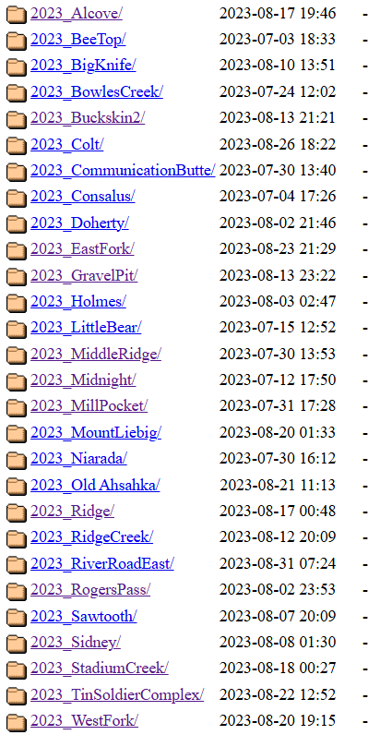
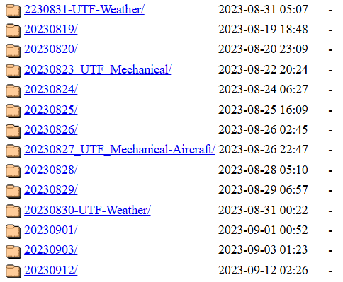
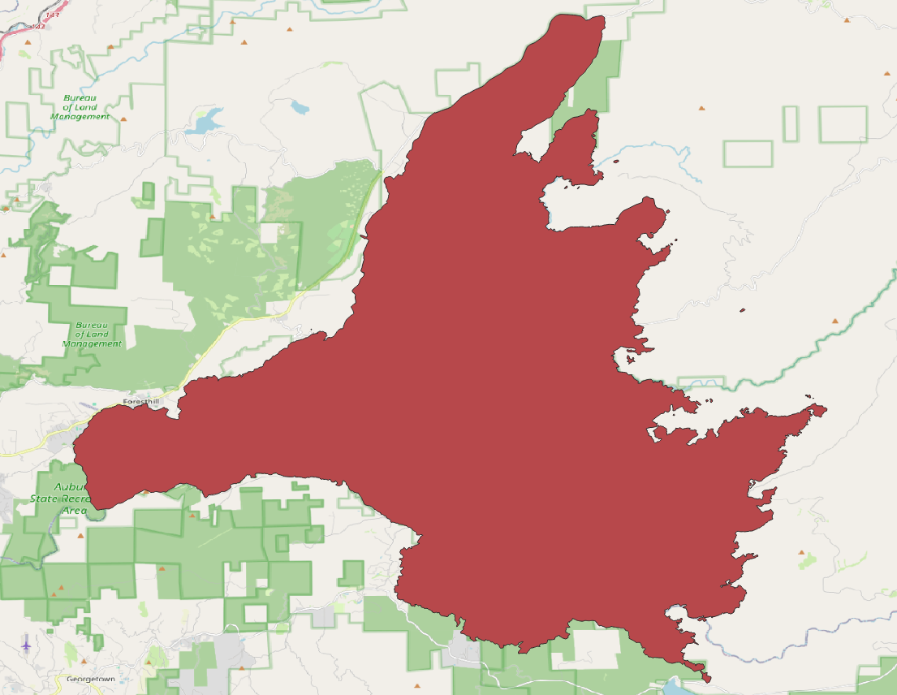
Database of NIROPS perimeters
https://ftp.wildfire.gov/public/incident_specific_data/

Slide 3
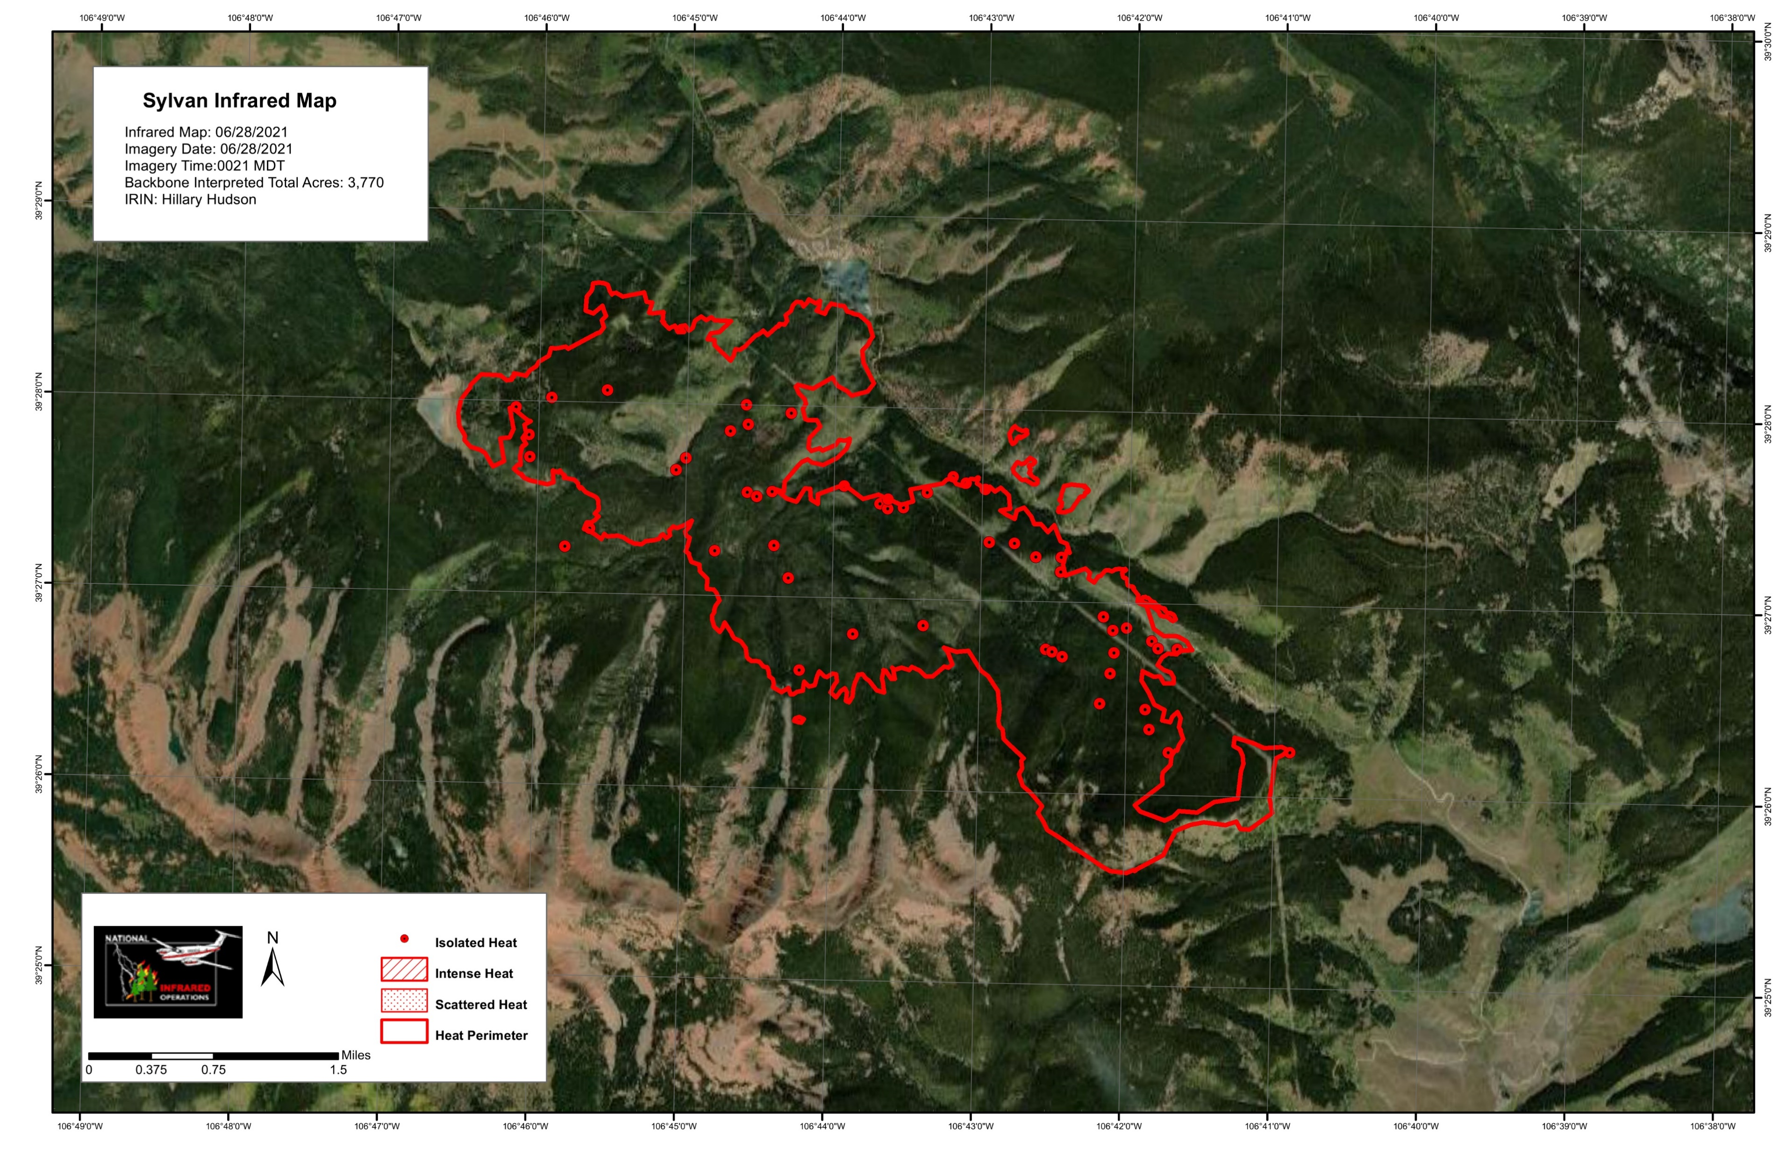

Background with NIROPS
https://ftp.wildfire.gov/public/incident_specific_data/

Slide 4
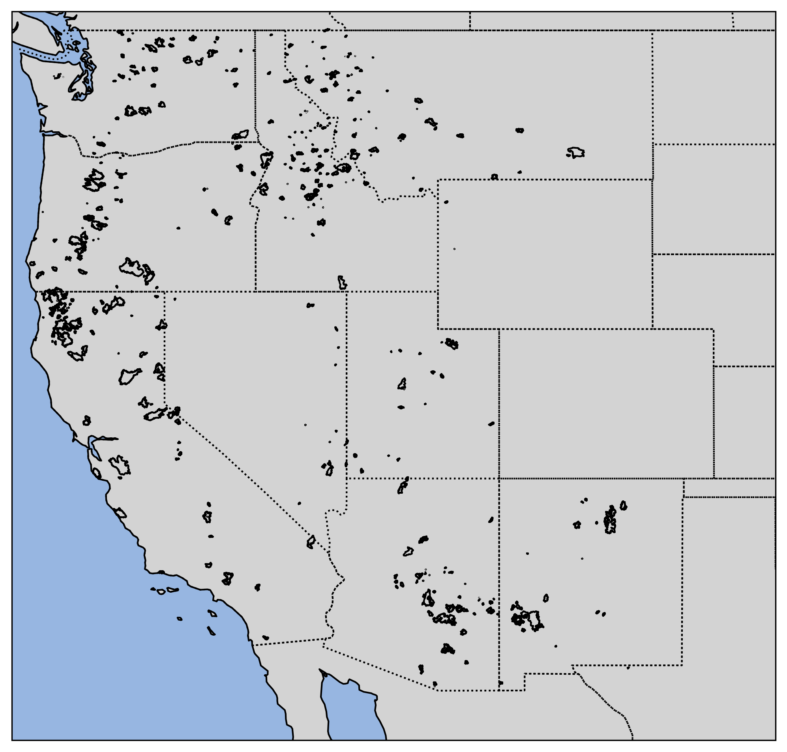
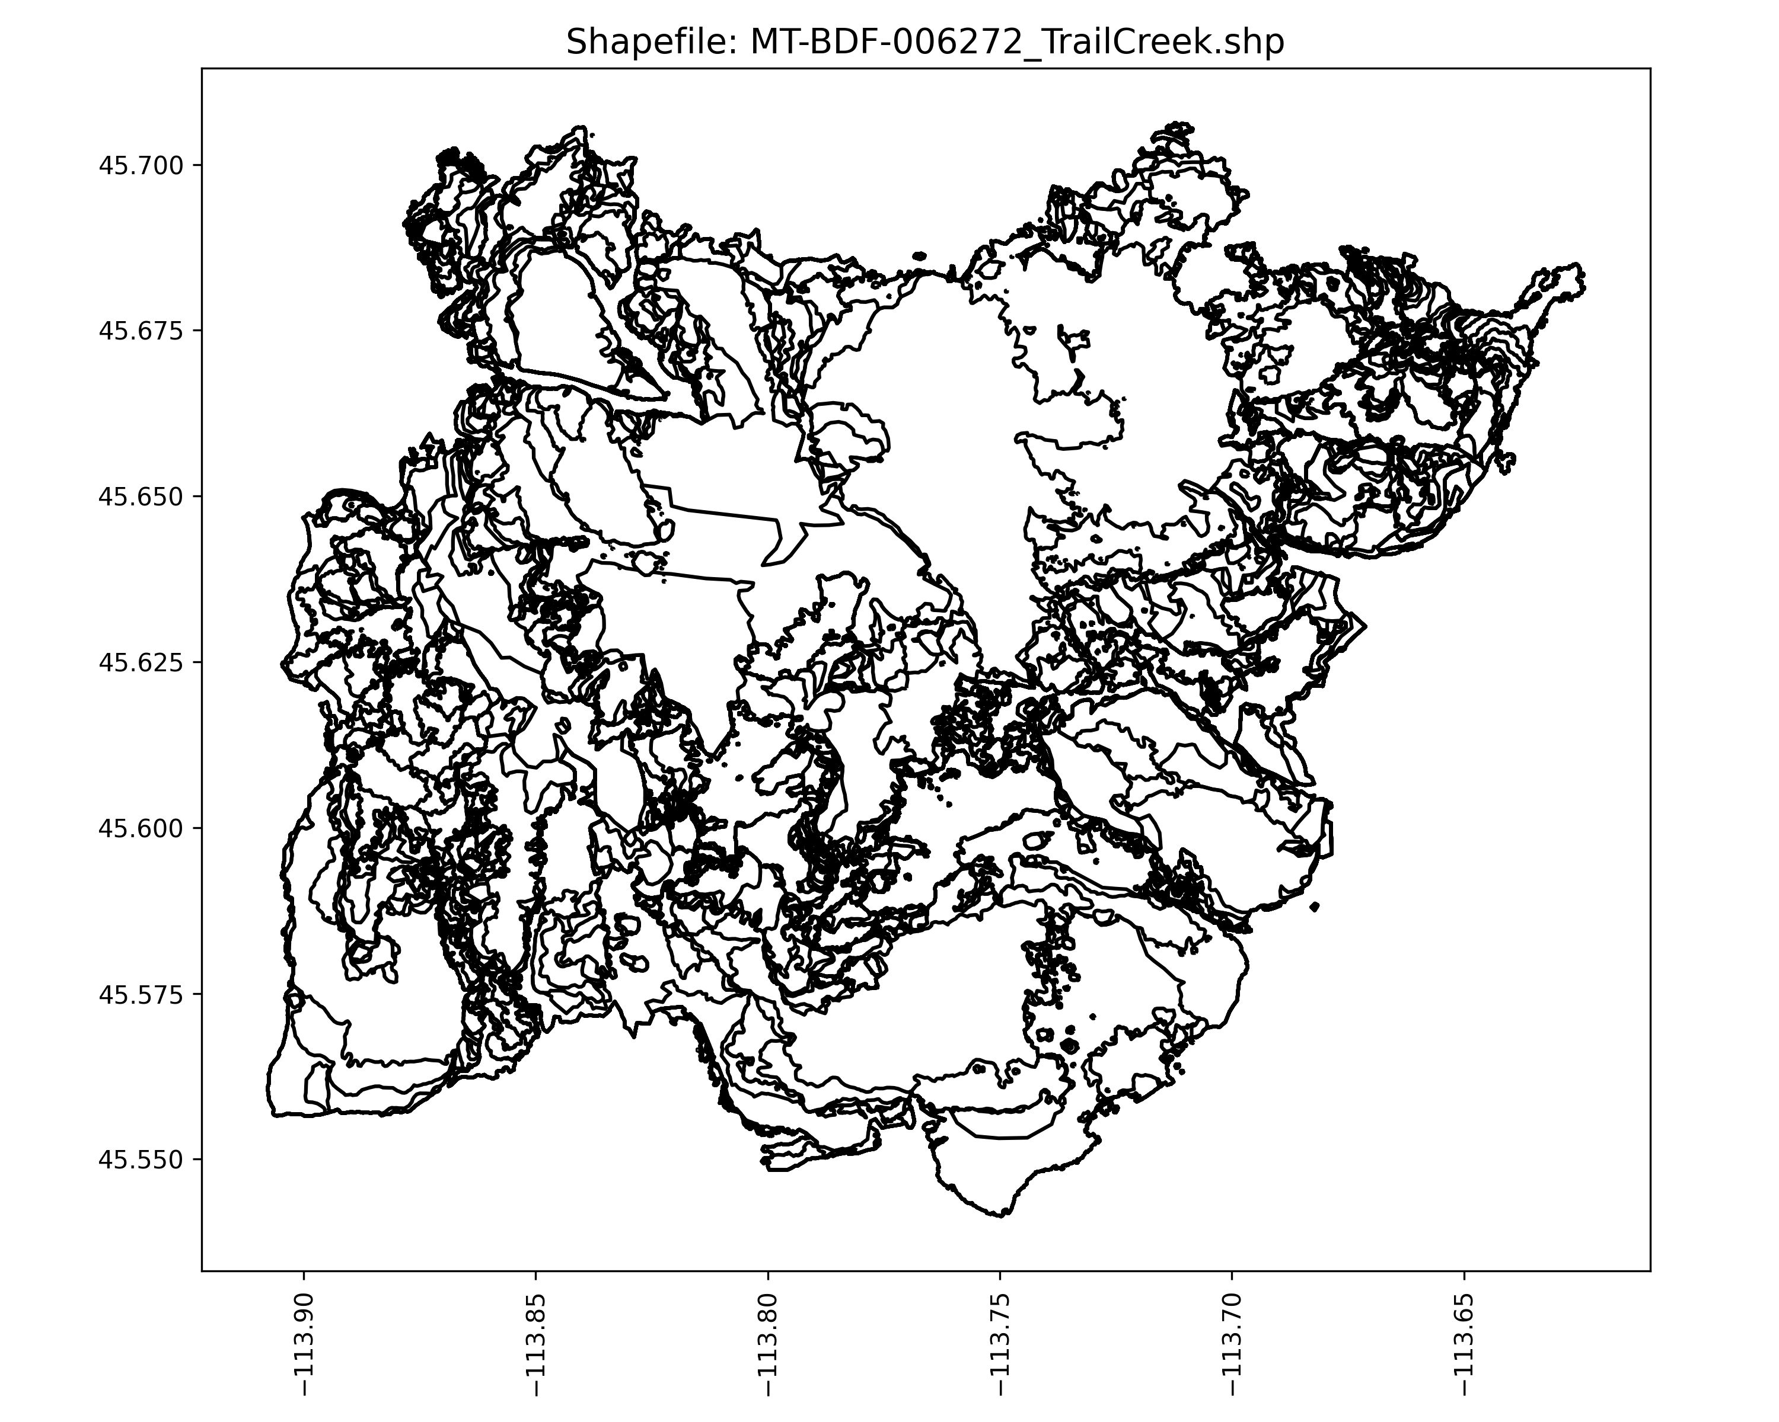
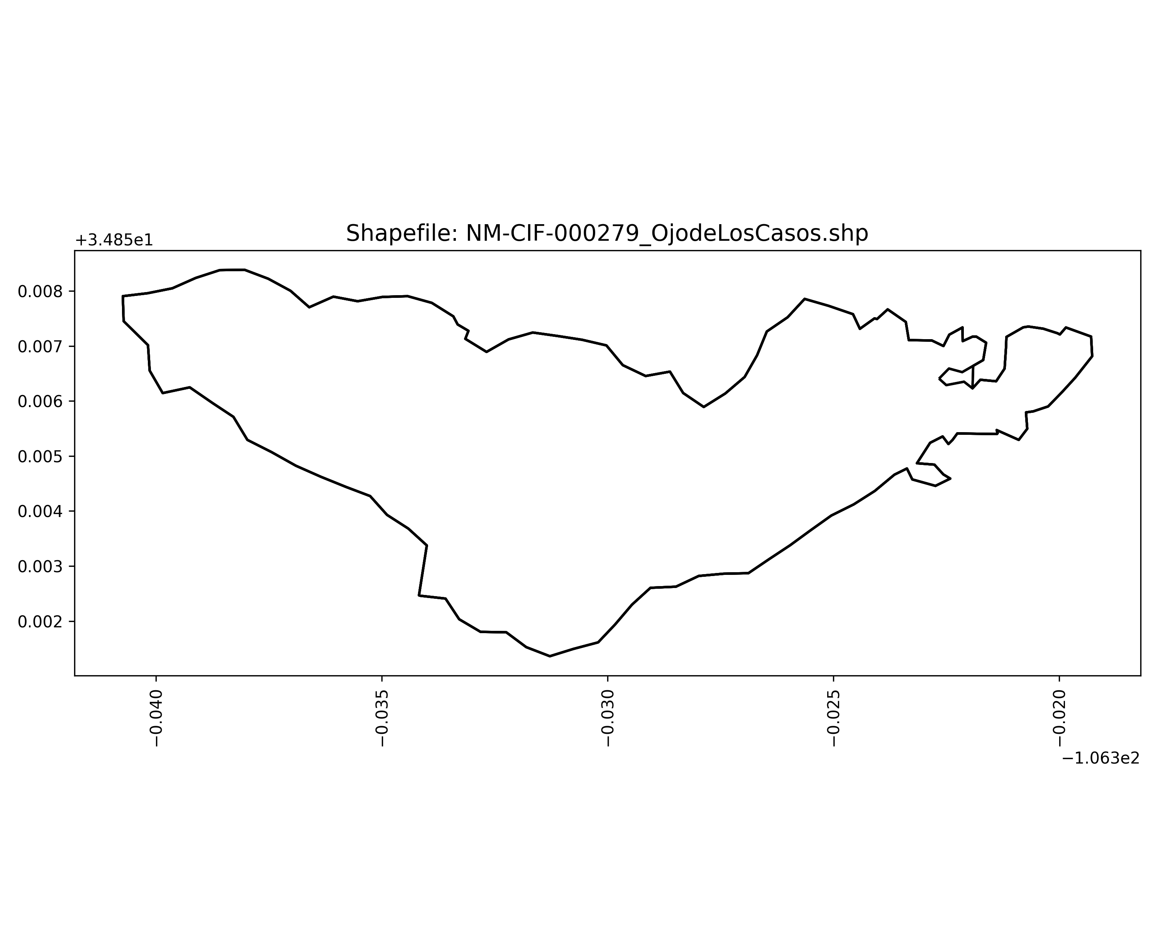
Dataset Release
> 400 Incidents
Notes:
3+ days and at lease on set of sequential days

Slide 5
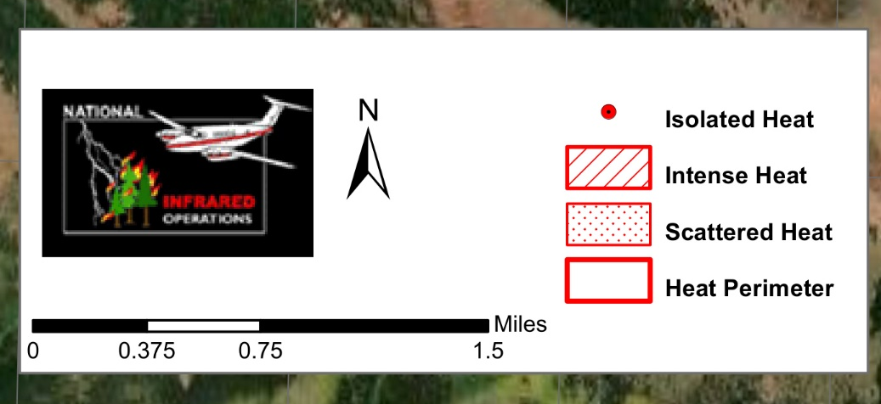
Background with NIROPS
https://ftp.wildfire.gov/public/incident_specific_data/

Slide 6
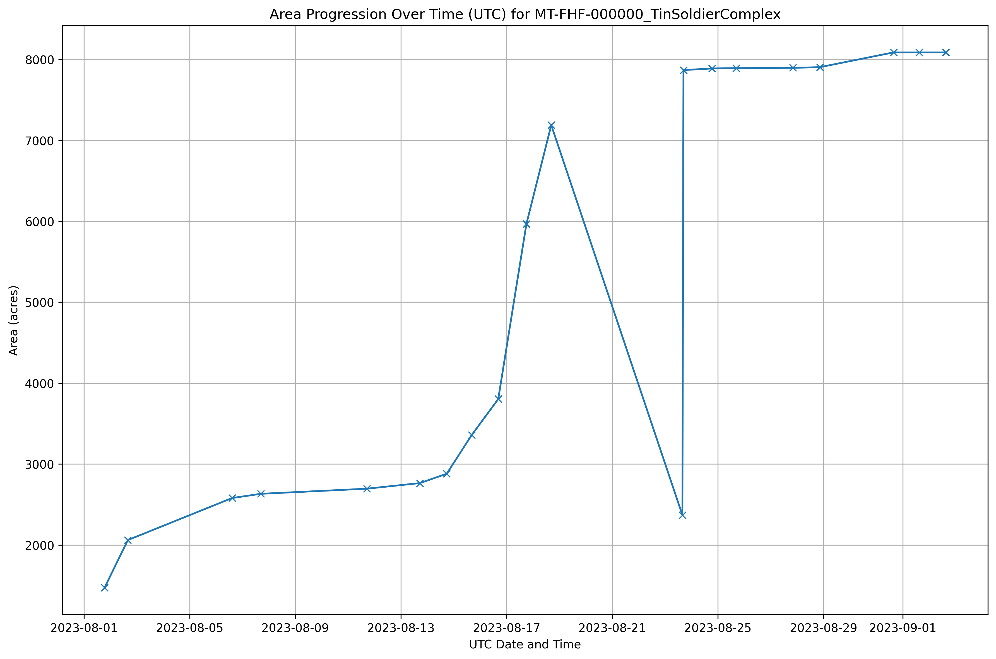

Slide 12
Automated Fire Perimeter Generation from Infrared Imagery

Slide 13
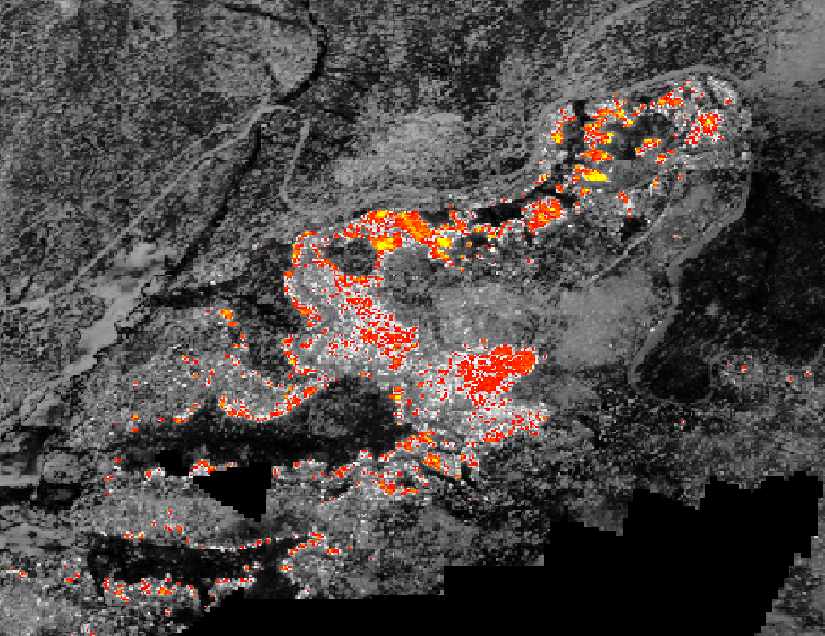
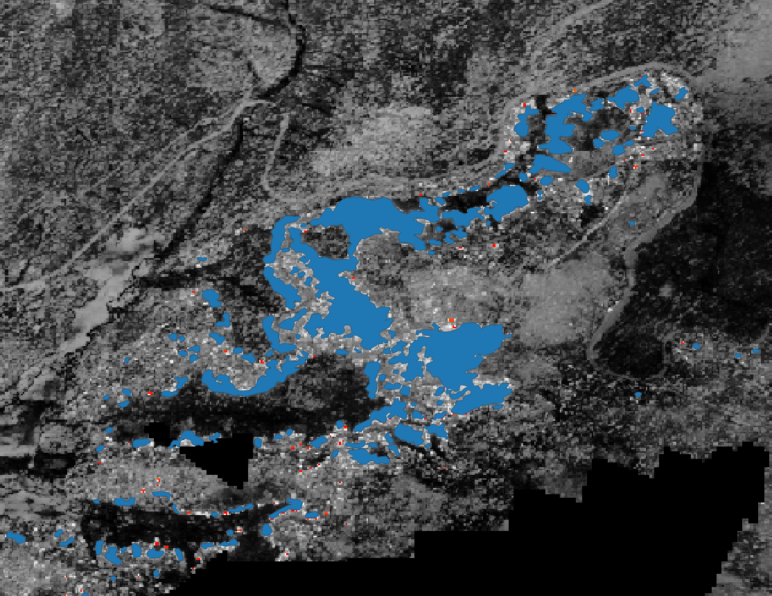
Infrared Interpreters

Slide 14
Primary Motivation and potential challenges
1) Automation can mean standardization
2) Reduces interpreter fatigue
3) May be easy to identify burning pixels but difficult to transform them into meaningful perimeters

Slide 15

Objective: This project processes imagery through a deep learning model to generate predictions, which are then transformed using an adaptive alpha shape technique to create vector shapefiles required for management applications.

Slide 16
Infrared Interpreters

Slide 17
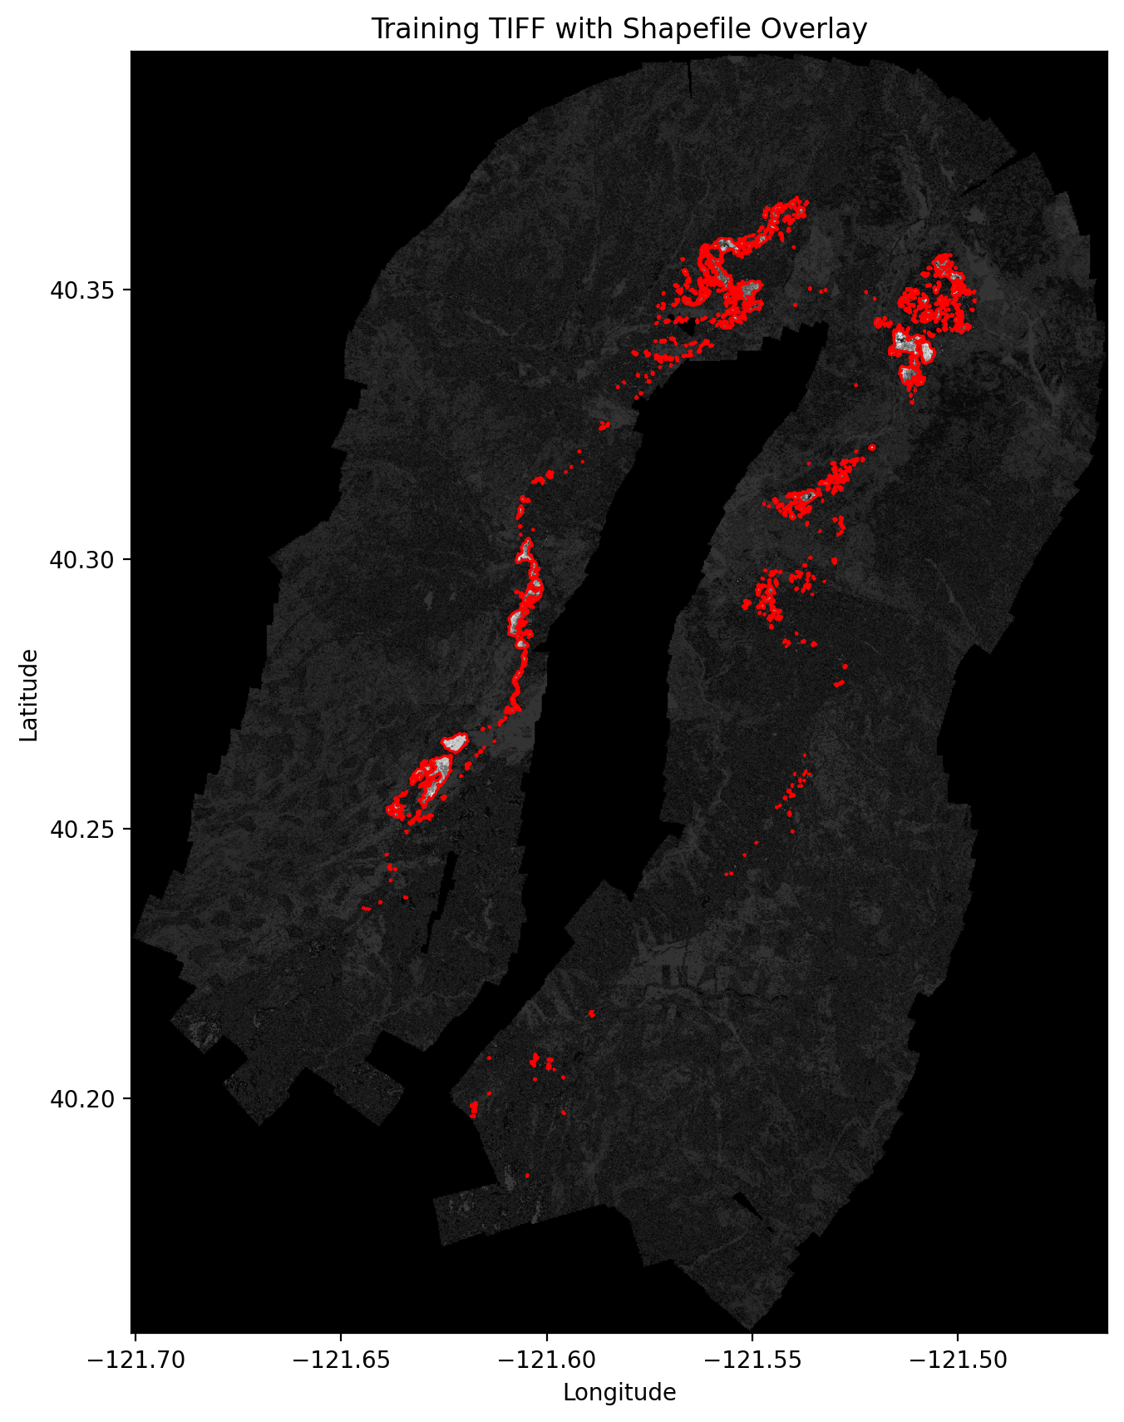
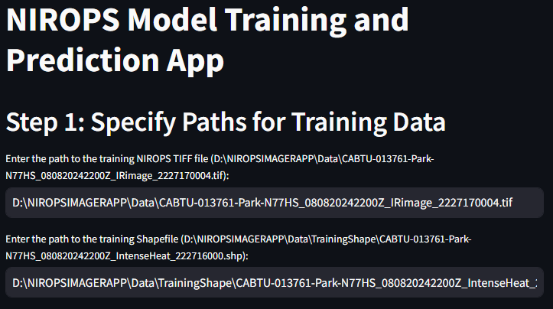
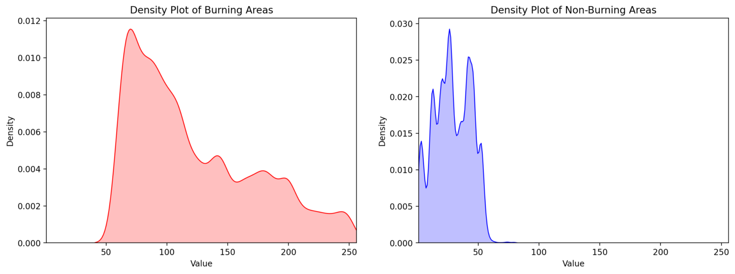
Pixel values inside perimeters
Pixel values outside perimeters

Slide 18

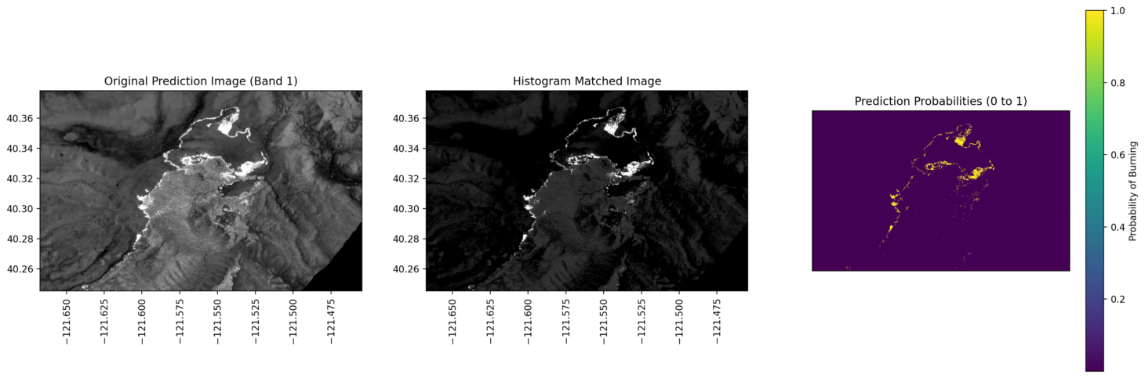
Notes:
The match_histograms function adjusts the distribution of pixel values in one image (the source image) to match the distribution of pixel values in another image (the reference image). This is often used in image processing to make two images more comparable, especially when they have different lighting conditions, contrast, or sensor characteristics.

Slide 19
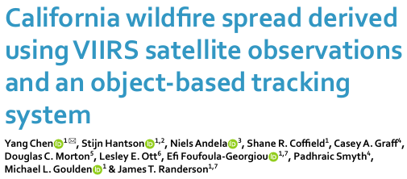
Alpha Shape Algorithm:
Definition:
An alpha shape is a generalization of the convex hull. Instead of assuming that all points form the outer boundary of a shape, the alpha shape uses a parameter (alpha) to define the scale of detail in the boundary.
Larger alpha values allow for tighter fitting boundaries around points, capturing finer details and concavities.
Smaller alpha values result in smoother, more generalized shapes.

Slide 20
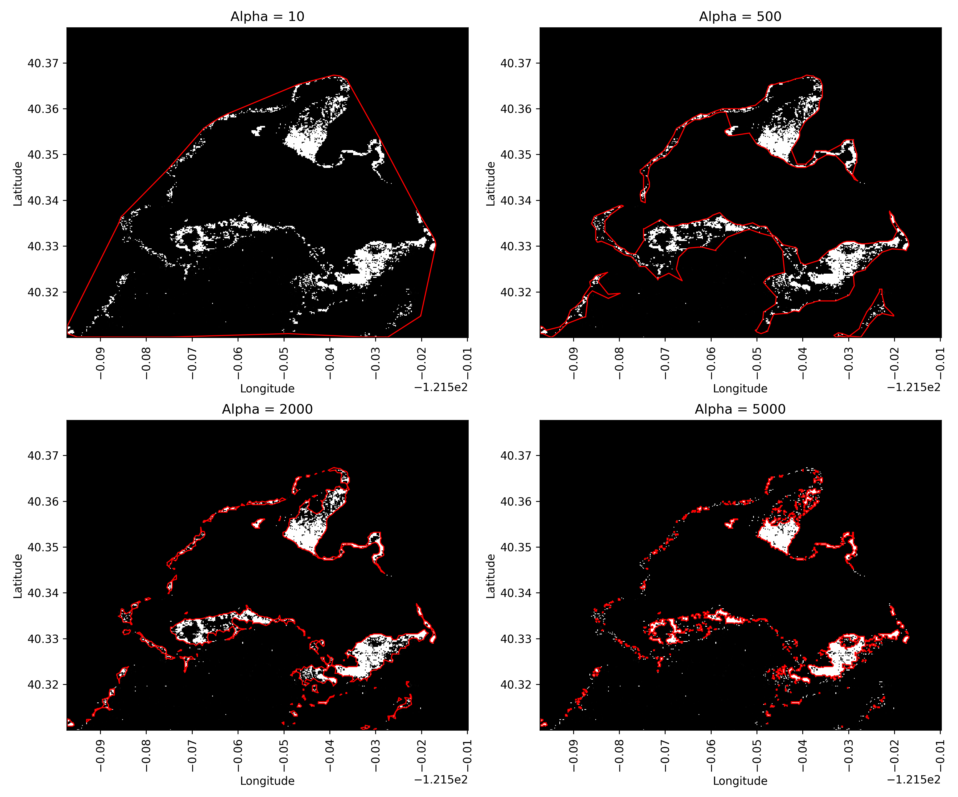
Notes:
adjusting alpha involves balancing the level of detail you want to preserve (precision) against the need for a cleaner, more interpretable representation of the data’s overall distribution (generalizability).

Slide 21
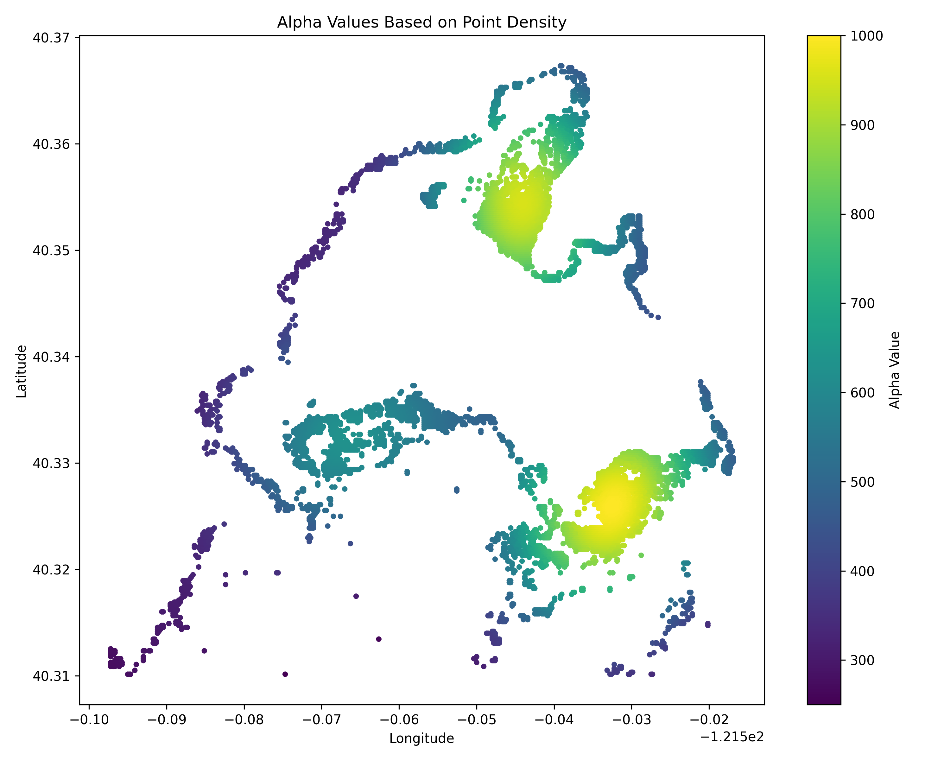
Density-Adaptive Alpha Shapes

Slide 22
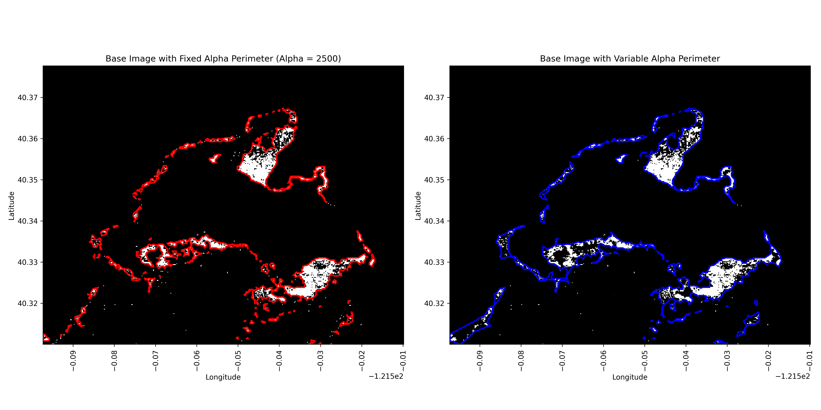

Slide 23
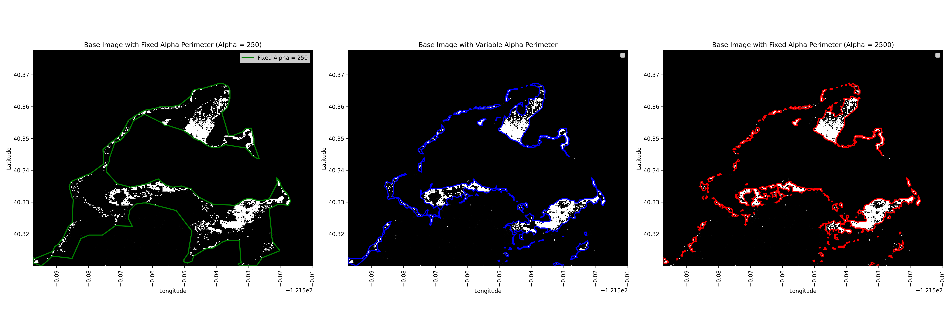
Variable Alpha – Generalizes well in scattered heat regions

Slide 24
Variable Alpha – Generalizes well in scattered heat regions
Fixed Alpha
Variable Alpha

Slide 25

Variable Alpha - While also retaining precisions

Slide 26
Generalizing & Retaining Precision

Slide 27
Comparison: Fixed Alpha vs. Variable Alpha
 | Fixed Alpha | Variable Alpha
Alpha Value | Single, constant value (e.g., 2000). | Adjusts dynamically based on point density.
Boundary | Uniform precision/looseness. | Adapts to clusters and sparse regions.
Use Case | Suitable for uniformly distributed points. | Ideal for heterogeneous, uneven distributions.
Flexibility | Limited to one alpha value. | Flexible; accounts for local density variations.

Slide 28
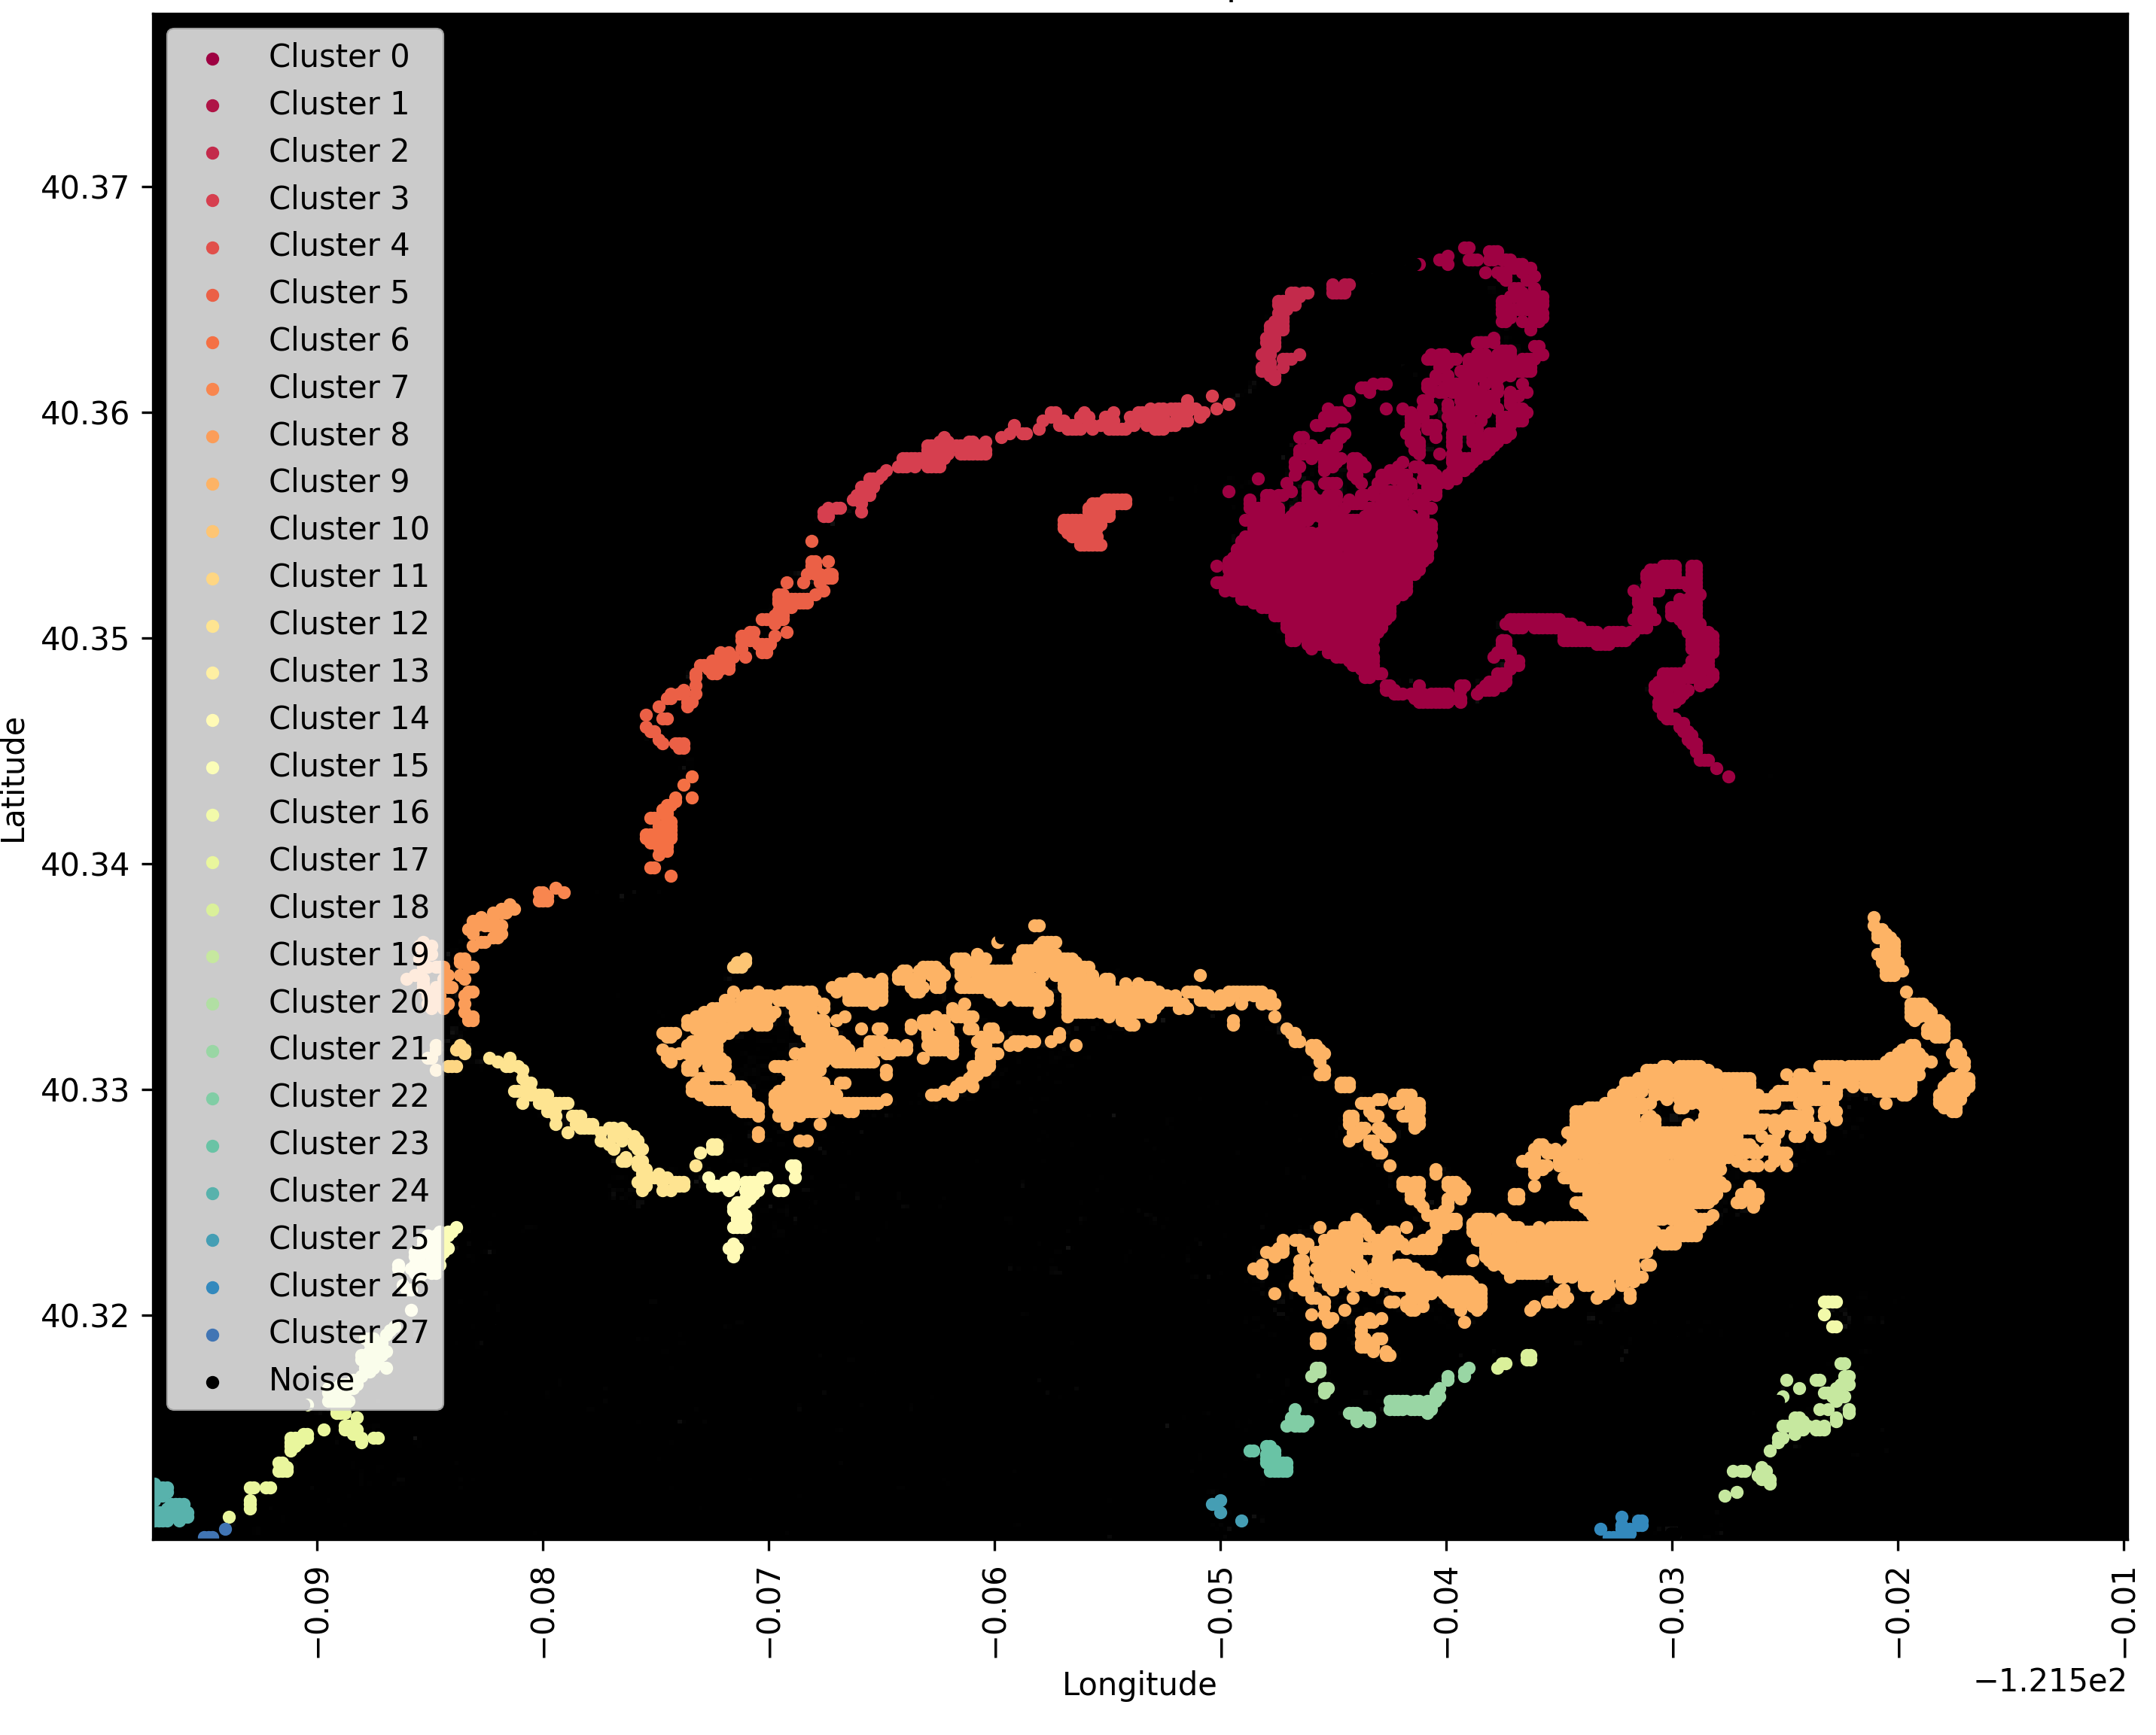
Notes:
Another approach is to first use a clustering algorithm and then apply the Density-Adaptive Alpha Shapes

Slide 29
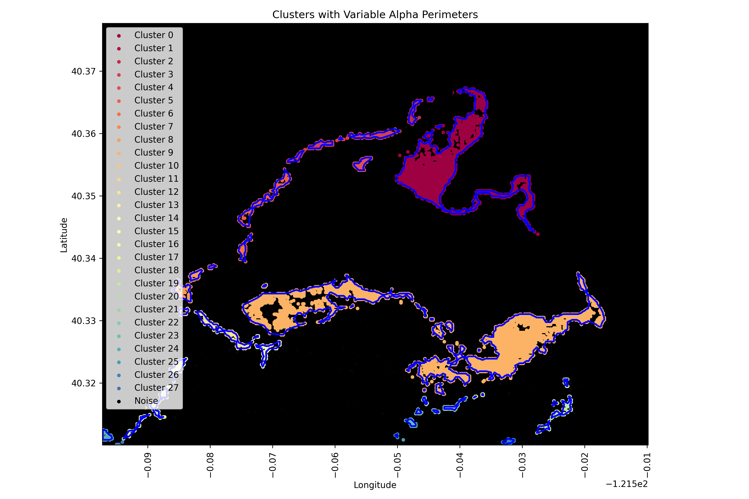
Notes:
Clustering the data first helps isolate regions of similar spatial patterns, enabling the density-adaptive alpha shape to better capture localized boundary variations and reduce the influence of noise or distant outliers.

Slide 30
Final Thoughts
Operational Benefits - Increase throughput, minimize delivery delays, and reduce reliance on costly trained analysts
Can integrate with FireCON and other applications
Fatigue drives the need for automation, enabling a standardized process

